Slide 1
Microsoft Purview and Qivada ADA
Data Classification in Practice

Slide 2
Agenda
Main Methods of Data Identification Classification and Term
Classification Definition and how to use
Term Definition and how to use
Lineage See how data assets are related
Qivada ADA Custom lineage creation

Slide 3
Main Methods of Data Identification
Classification
Technical definition
Classify as ‘X’ if data contains value like ‘Y’
Classify as ‘X’ if schema (e.g., database column name) is like ‘Y’
Automated –and manual process
Term
Business definition
Create definition of term e.g., Salesperson. What is a salesperson?
Apply term definition manually to selected assets e.g., database tables and/or –columns
Implements glossary
Option to define data stewards and -experts

Slide 4
Classification
Definition and how to use

Slide 5
Classification
Definition for classification
System
100+ standard definitions such as “International Banking Account Number (IBAN)” or “Credit Card Number”
Custom
Create your own classification
Name………………………….. ADA Audit
Description………………… Qivada ADA audit structure

Slide 6
Classification Rule
Define when to apply classification
System
Classification rules for all system provided classifications
Microsoft Purview classifies data by using RegEx, Bloom Filter and Machine Learning models (Source)
Custom
Create your own classification rule
Name………………………….. ADA Audit
Description………………… Qivada ADA audit structure
Classification name…. ADA Audit
Type……………………………. Regular expression –or– Dictionary
Notice that regular expression can be applied to data and/or schema e.g., column name. Dictionary applies only to data

Slide 7
How to Apply Custom Classification
Name
Description
Type
Regular expression
Dictionary
1. Create classification
2. Create
classification rule
Name
Description
1
0..n
Manual classification only
Automated classification
1..n
1..n
Source type
System rules
Custom rules
3. Create
scan rule set
4. Create
scan
1
0..n

Slide 8
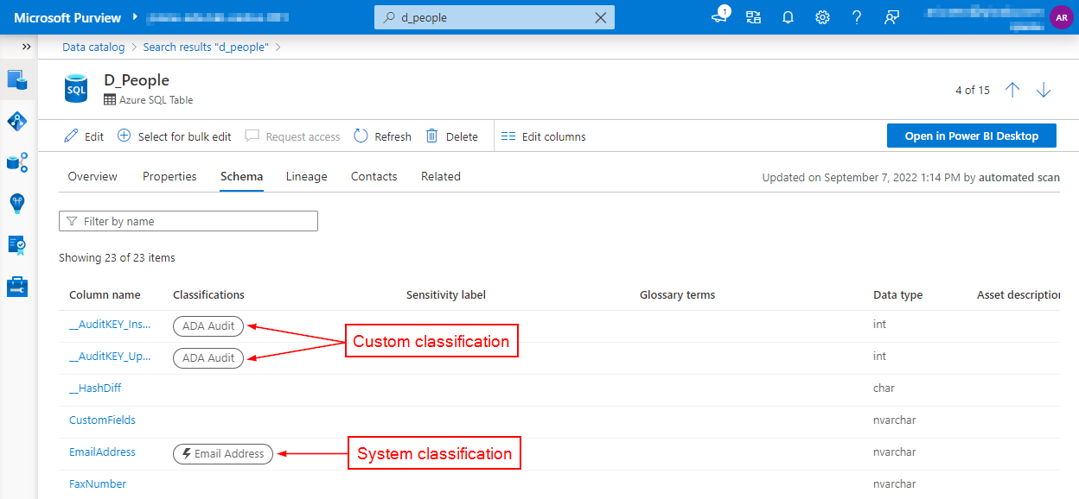
Purview Example

Slide 9
Term
Definition and how to use

Slide 10
Term
Definition for term
Template…… System default / custom template
Status………… Draft / Approved / Expired / Alert
Name…………. Salesperson
Definition…… a person whose job is to sell a product or …
Parent…………
Acronym…….
Resources…. List of URLs e.g., definition on Merriam-Webster
Contacts
Experts
Stewards

Slide 11
How to Apply Term
Name
Description
…
1. Create or import terms
2. Navigate to asset
3. Apply term to asset

Slide 12
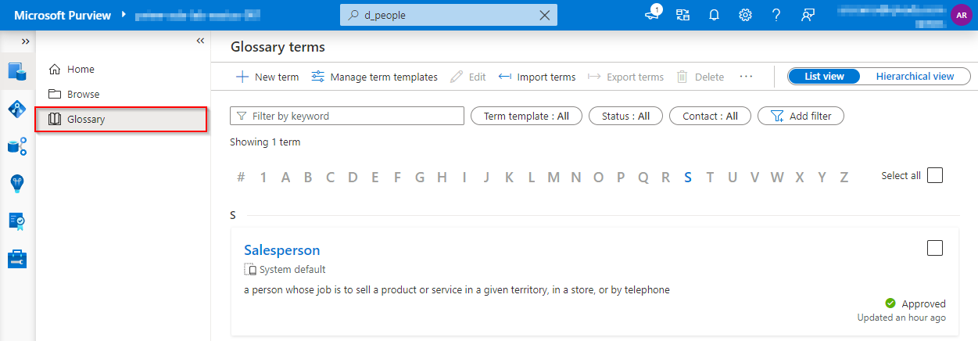
Purview Example / Glossary

Slide 13
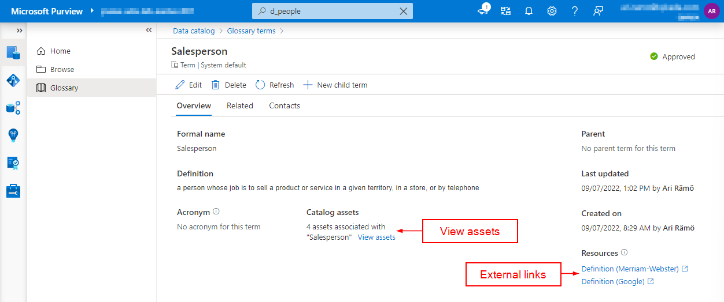
Purview Example / Term

Slide 14
Lineage
See how data assets are related

Slide 15
Lineage
What is lineage
Lineage is relationship between one or more data assets through process
Experiences with lineage
Purview might not be able to scan lineage from data sources. In this case custom lineage can be created programmatically using Purview API. Notice that purview portal does not allow manual definition of lineage objects. Lineage objects can be created only with programmatic interface

Slide 16
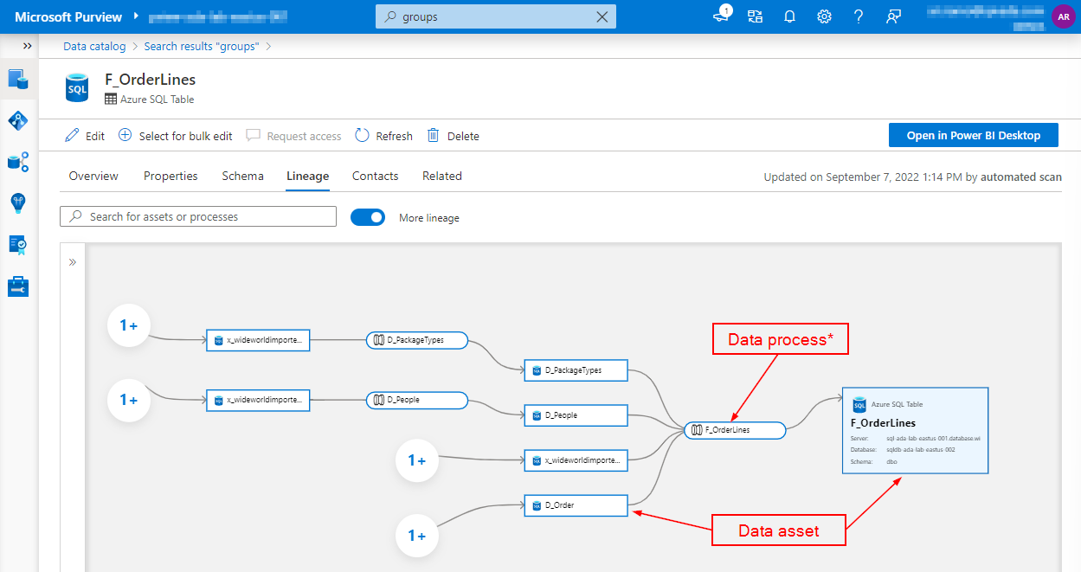
Purview Example
^{*)} Lineage created with Qivada ADA

Slide 17
Qivada ADA
Custom lineage creation

Slide 18
How to Create Custom Lineage
1. Create data flow definition(s)
2. Execute
purview lineage creation
Source data
Target data
Qivada ADA
Microsoft Purview
Lineage enriched with Qivada ADA is available on Microsoft Purview

Slide 19
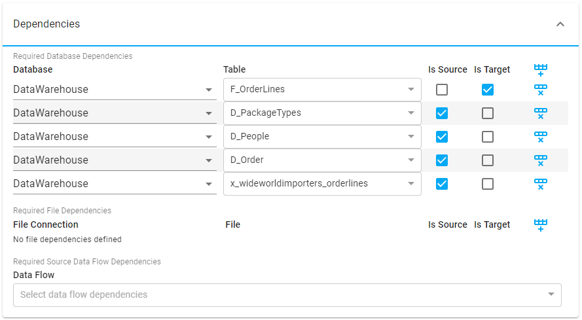
Qivada ADA Example / Data Flow
^{*)} Example for simple “lineage only” definition

Slide 20
Thank you
Ari Rämö
Partner, Product development
+358 50 367 4561
ari.ramo@qivada.com
qivada.com

